Slide 1

Serverless in Openshift

Slide 2
What is Serverless Computing?
No Infrastructure to provision and configure
On-Demand Execution
Auto-scaling
Per-second billing

Slide 3
What is Knative?
A set of middleware components build on Kubernetes
Brings serverless computing to containers and Kubernetes
Simplifies deploying modern applications on Kubernetes
Simplifies deploying modern applications on Kubernetes
Encourages best practices for designing and deploying cloud native and serverless application.
Makes cloud native applications portable
On-premises
Hybrid
Multi-cloud

Slide 4
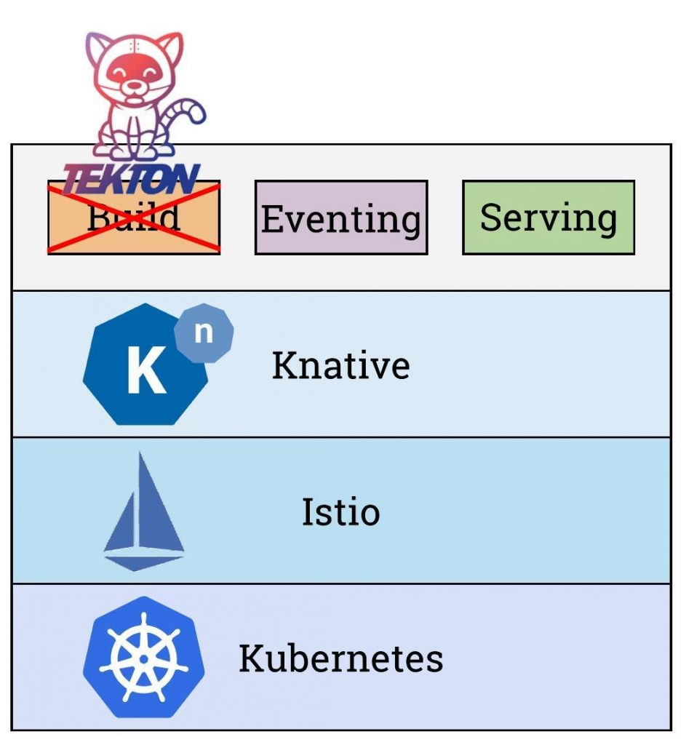
Knative Architecture
The Knative platform consists of three core components that mirror the function lifecycle:
Build controls the process of taking developers' code in the form of functions, building \and packaging it as a container that can be deployed via Kubernetes.
Serving deploys and runs these containers, and scales them up and down as needed by application functions.
Events provide the inputs to a function or the outputs of a function, such as an API request, new data, or a change to system.

Slide 5
Benefits
Activates and scales based on request (up/down to 0)
Manages code/config revisions
Integrates service mesh (request path/services access control)
Supports custom domains and certificate management
Pluggable
Connect with other GCP services like cloud builds and stack drivers.
Extend with parterner integration like Gitlab and Datalog

Slide 6
Demo

